Slide 1


Evaluating Interactive Tasks through the Lens of Computational and Algebraic Thinking, Interactivity Types, and Multimedia Design Principles
Yasemin GULBAHAR, Tugba ÖZTÜRK, Valentina DAGIENĖ, Marika PARVIAINEN, Ismail GÜVEN, Javier BILBAO

Slide 2
INTERACTIVE TASKS
An interactive task is a problem-solving activity that requires the learner to interact dynamically with digital elements (such as buttons, drag-and-drop items, simulations, or animated systems) in order to complete the task or reach a solution.
Interactive tasks employ a variety of interaction types to engage learners:
Click-to-change
Click-to-select
Drag-and-drop
Match pairs
Observe the simulation
Draw components
Special interactivity

Slide 3
Cognitive Theory of Multimedia Learning
A key aspect is the limited capacity of working memory
Active learning, where learners actively select, organize, and integrate information, and his principles guide the creation of materials that support these processes for better learning
Extraneous load, or wasted mental effort, arises from non-essential elements that do not aid learning. To reduce this, instructors should stick to the core content and avoid distractions like unnecessary animations or irrelevant details.
Intrinsic load, or the essential mental effort of processing the material itself, depends on its complexity. Instructors can manage this by breaking down content into smaller parts and explaining technical terms beforehand.
Germane load, or the effort learners put into truly understanding the material, is heavily influenced by their motivation. Instructors can boost this by providing learning support and pacing the content well.

Slide 4
Principles of Multimedia Learning
Multimedia Principle: Combining words and pictures is more effective for learning rather than using words alone.
Modality Principle: Presenting related information visually and audibly is better than using just one of these methods.
Redundancy Principle: Avoid presenting the same information both as onscreen text and as spoken narration.
Coherence Principle: Learning is improved by excluding any unnecessary content.
Signaling Principle: Using cues to highlight important information and the structure of the material enhances learning.
Spatial Contiguity Principle: Placing related text and visuals close together improves understanding.
Temporal Contiguity Principle: Presenting spoken words and corresponding graphics simultaneously is more effective.
Segmenting Principle: Breaking down lessons into smaller, manageable parts helps learners.
Pre-training Principle: Providing necessary background information before the lesson improves learning.
Image Principle: Use relevant graphics that help explain the content and support learning objectives.
Personalization Principle: Avoid formal language and instead use a conversational tone to engage learners.
Voice Principle: A friendly human voice is better for narration than a computer-generated one.

Slide 5
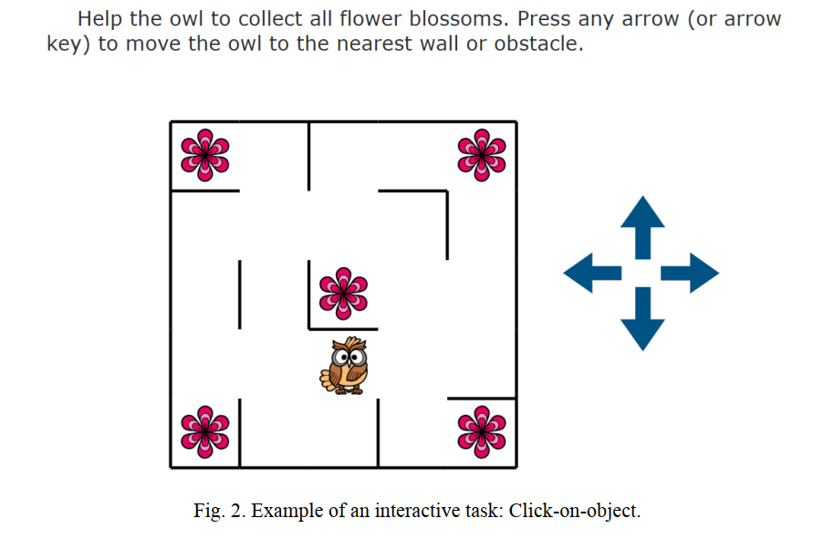
THE SIGNALING PRINCIPLE

Slide 6
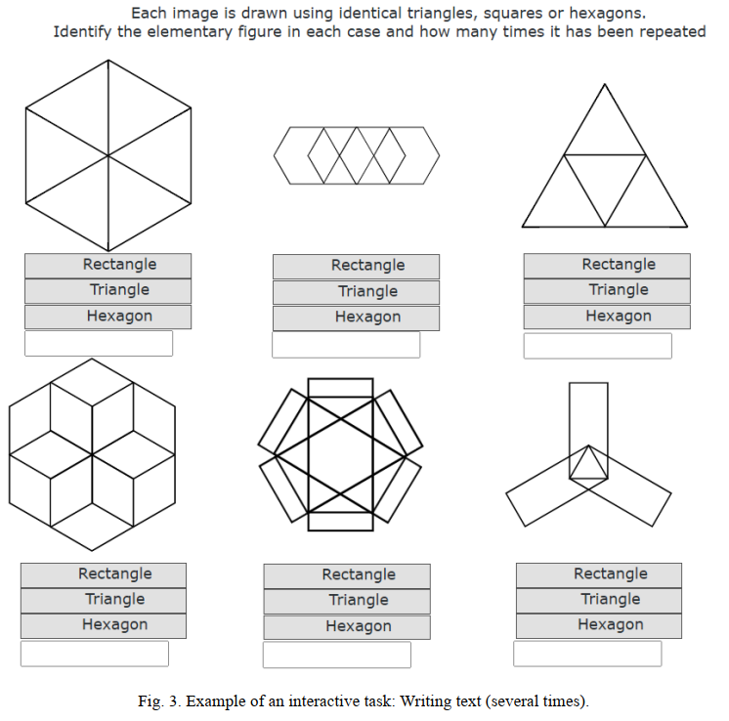
The Temporal Contiguity PRINCIPLE
Presenting spoken words and corresponding graphics simultaneously is more effective.

Slide 7
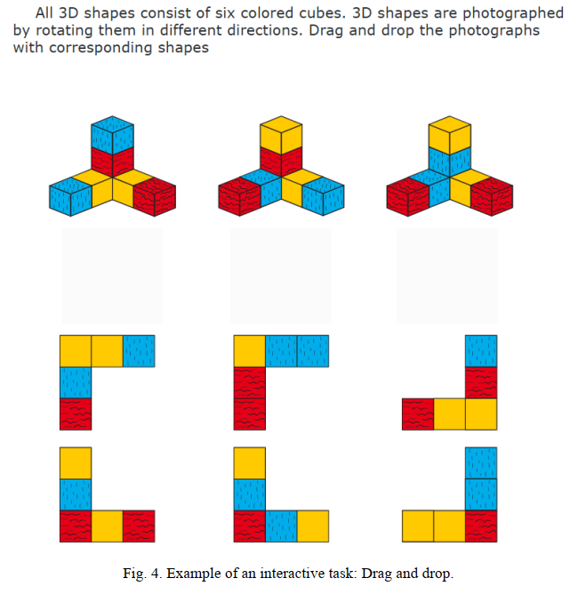
The SEGMENTING PRINCIPLE
Breaking down lessons into smaller, manageable parts helps learners.

Slide 8
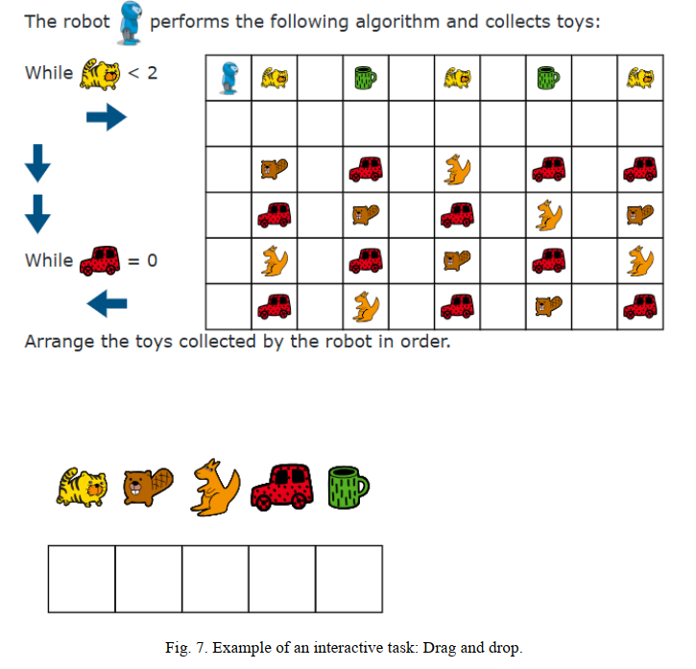
The IMAGE PRINCIPLE

Slide 9


Bebras – international challenge on Computational Thinking and Informatics

Slide 10

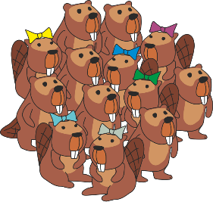
A broad network of informatics teachers has been established
It has been active for 20 years and connects over 80 countries.

Slide 11
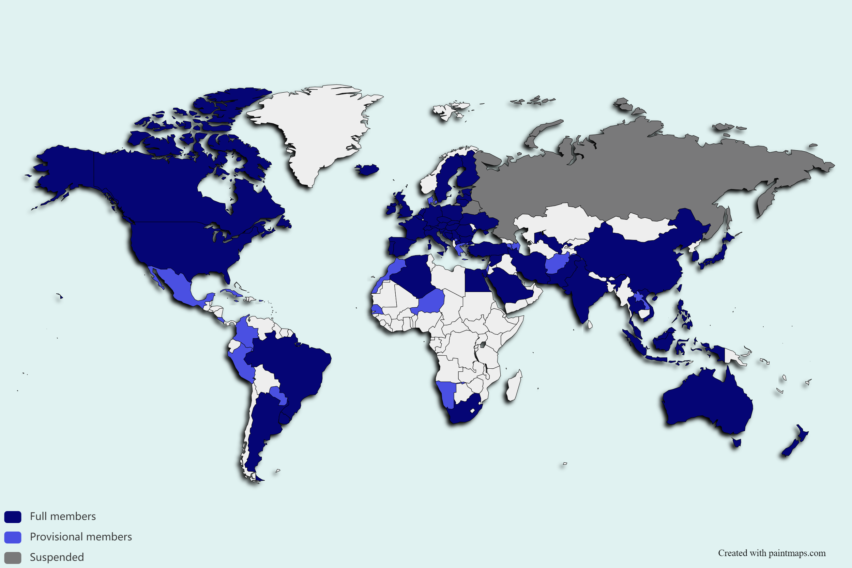
Bebras countries 2025

Slide 12
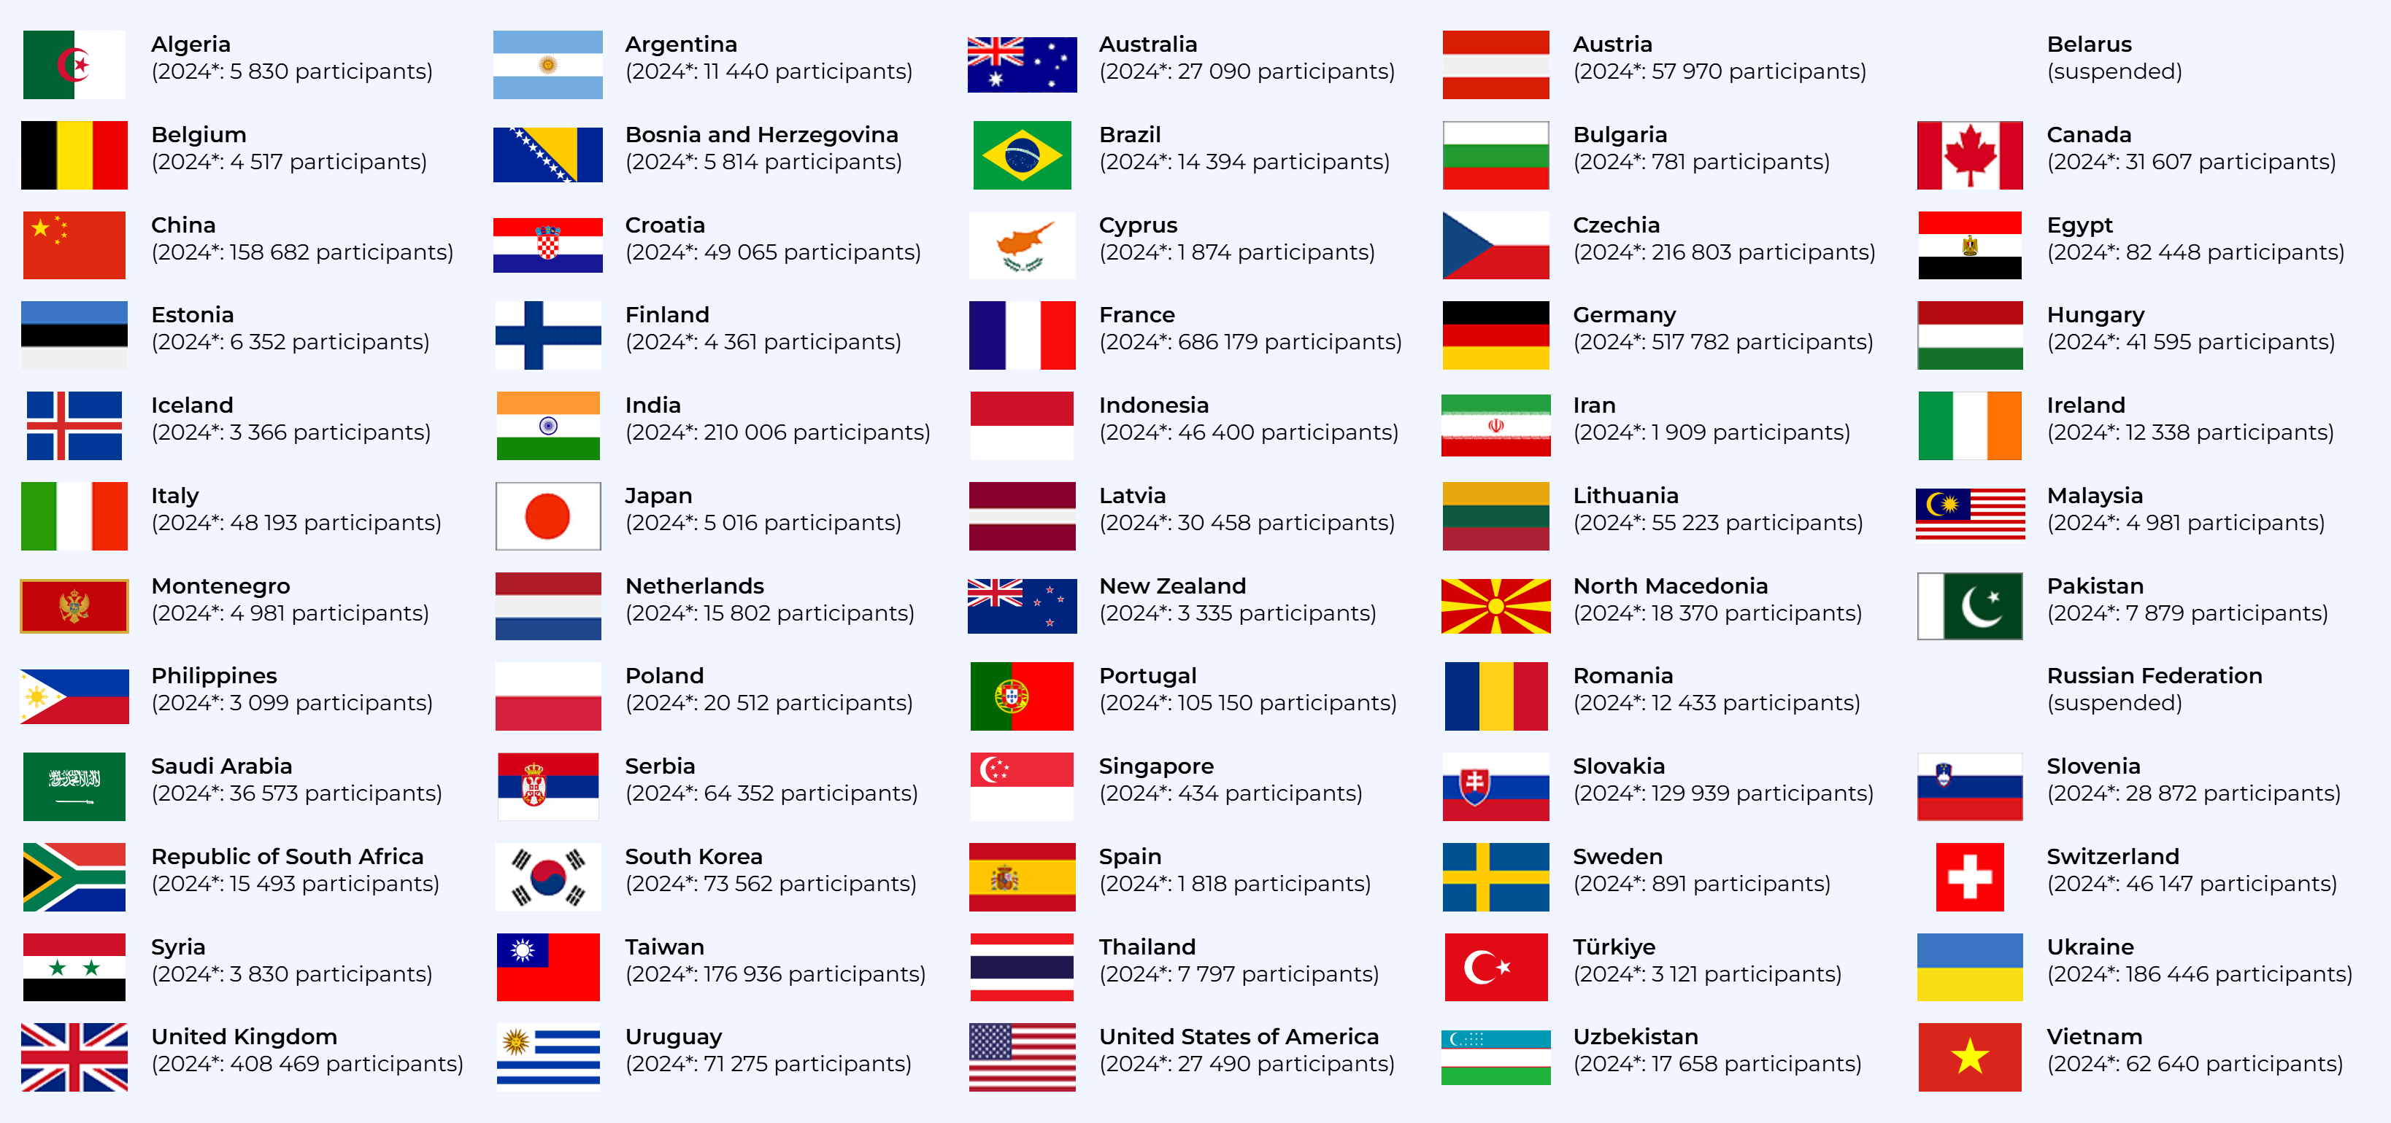

Bebras challenge 2024-2025
60 full members

Slide 13
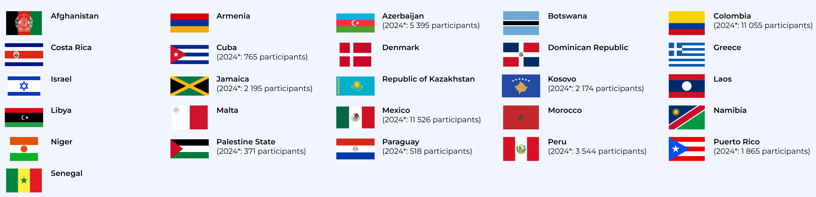

Bebras challenge 2024-2025
26 provisional members

Slide 14

A wide range of activities for learning informatics
Bebras tasks – gamification
Captures students' attention
Requires deeper thinking in the field of informatics
Clearly linked to core informatics concepts

Slide 15
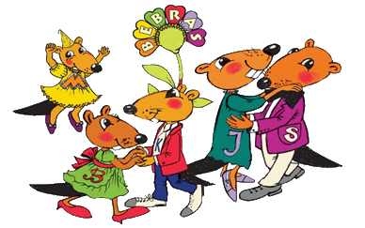
Bebras Tasks
6 age groups:
I age 5-8
II age 8-10
III age 10-12
IV age 12-14
V age 14-16
VI age 16-19
pupils have to solve 15-24 tasks within 40-60 minutes
interactive tasks, open ended, multiple-choice
2-4 minutes per task
easy, medium and hard tasks
Age group
Grades
Pre-Primary
Primary
Benjamin
Cadet
Junior
Senior
1 | 2 | 3 | 4 | 5 | 6 | 7 | 8 | 9 | 10 | 11 | 12 | 13

Slide 16
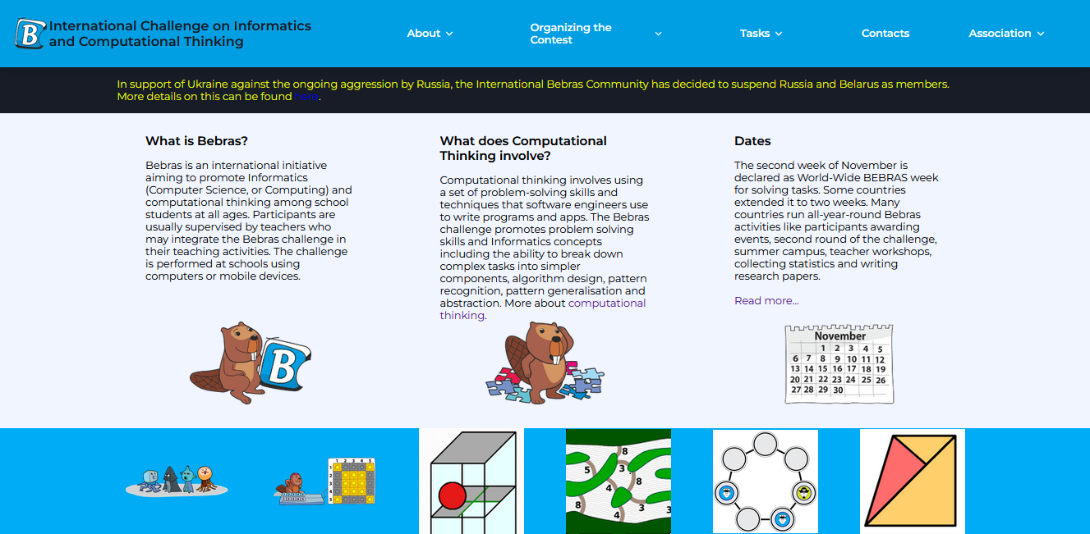
Bebras website: www.bebras.org

Slide 17
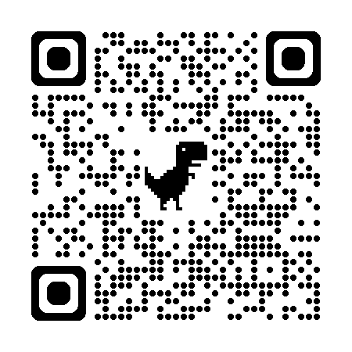
Solve interactive Bebras tasks

Slide 18
Thank you
Valentina Dagienė
Vilnius University
Lithuania
valentina.dagiene@mif.vu.lt
This work has been co-funded through the European Union. Information about the project is on the CT&MathABLE website: https://www.fsf.vu.lt/en/ct-math-able

